Slide 1

Meet the Teacher
Year 4
2026 -2027

Slide 2

Year 4 Staff
Miss Wright – Class Teacher
Miss Ridsdale – TA Support (All Year Groups)
Mrs Milenkovic – 1-2-1 TA Support
Miss Robinson – 1-2-1 TA Support
Mrs McDougall – 1-2-1 TA Support

Slide 3

Timetables
PE days:
Mondays and Wednesdays
Homework set on a Wednesday and due the following Tuesday (Century/Writing)
Spelling – will be set and tested weekly (from next week)
Forest School Friday – throughout the year, we will dojo to remind when this is happening (old clothes and wellies will be needed for this)

Slide 4

Uniform
White shirts / polo shirts (shirts and ties after October Half Term please).
Blue skirts (or blue check summer dresses until Oct Half Term) /
grey trousers or shorts
Navy jumper or cardigan – with school logo if you prefer
Dark socks and black shoes
Long hair needs to be tied up - blue / white / black hair bobbles
No jewellery (in particular, earrings)
Watches may be worn (no smart watches).

Slide 5

PE Kit
Plain white t-shirt (or new school logo PE shirt)
Navy jumper
Navy shorts / joggers
White socks
Trainers

Slide 6


Rewards / Consequences
We use class dojo to record behaviour.
Good behaviour in line with our values is rewarded with dojo points.
At the end of each week, the child with the most points will be recognised in assembly and receive a certificate.
Negative behaviour is class will result in a warning being given. If behaviour continues, 2 minutes thinking time is given. If behaviour continues, this increases to 5 minutes and then it will be 10 minutes with another teacher or Phase Lead.
Children will pay this time back during break/lunch time.
We will endeavour to inform you of these events.
Serious bad behaviour - physical incidents or bad language will be
reported straight to Mr. Fowler or Mrs Green.

Slide 7
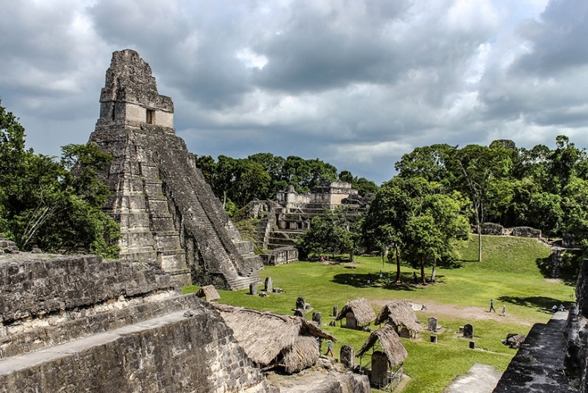
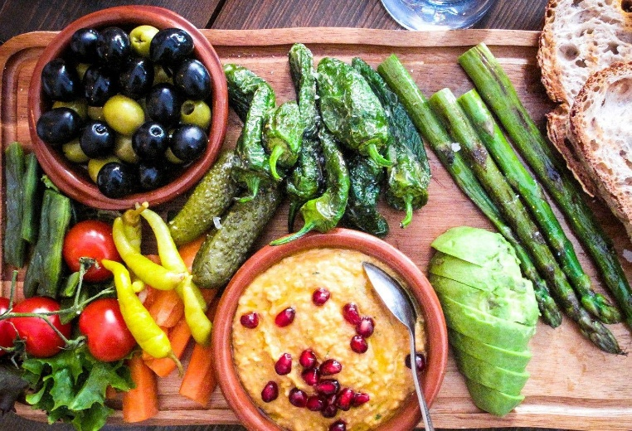

Year 4 Topics
Autumn Term – Ancient Maya/Why are Rainforests important to us?
Spring Term – Anglo Saxons/Where does our food come from?
Summer Term – How have children’s lives changed?/What are rivers and how are they used?

Slide 8

Some of the books we will be reading…
The Wreck of the Zanzibar
Flo of the Somme (Remembrance)
Where on Earth – Rainforests
The Firework Makers Daughter
The Iron Man
What a Waste

Slide 9


Educational Visits
We are going to Cadbury World at the end of September.
We will also be visiting Kingsbury Water Park in the summer term (linked to our Rivers topic in Geography)
We as always will be seeing the Coventry Theatre
Panto, which is Beauty and the Beast this year.
We also hope to be visiting a Jewish Synagogue in the
Spring Term.
If any additional visits or events are added we will,
as always, contact you in plenty of time.

Slide 10

Homework
All children are expected to read for 10 minutes, at least three
times a week, ideally though this would be every night.
Please sign their reading diary pages in their organiser to confirm they have done so.
Reading books AND planners need to be in school every day.
Homework will be set on a Wednesday and due the following Tuesday. This will be done via Century and Spelling Shed.
As we have the Year 4 Times Table check it is also vital that children complete regular practice on TTRS, we ask you to aim
for 10 minutes per day – little and often is better than one longer session once per week.

Slide 11

Spellings
Spellings are being done in a new format this year.
We start the year with a 50-word common exception words baseline spelling test.
Then each week, a set of 10 words will be displayed in the classroom.
During that week, the children will complete activities linked to the spelling patterns and be taught to identify these words in our learning across all subjects. We also ask that they practice them at home.
At the end of the week, there will be a progress check on these words.
Children are formally assessed at the end of each term
to ascertain progress with another 50-word spelling
challenge.

Slide 12
Finally…
If your child is worried or upset or you are concerned about
anything at all, please get in touch.
Class Dojo messages are checked regularly.
Emails can be forwarded to us – please use the office email address
office@coppice.solihull.sch.uk
Urgent messages and reports of absences – please telephone the office.
Please do come to speak to me at the end of the school day if you have any questions.

Slide 13
We are looking forward to teaching your children this year.
Thank you for listening.
Any questions?

