Slide 1

Year 6 information evening
2026 - 2027

Slide 2
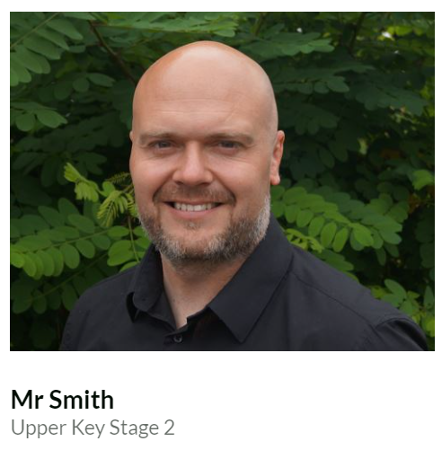
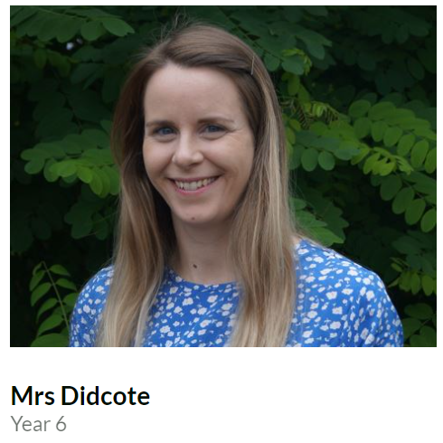
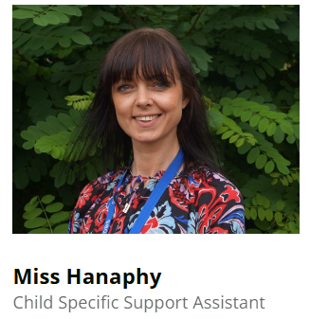
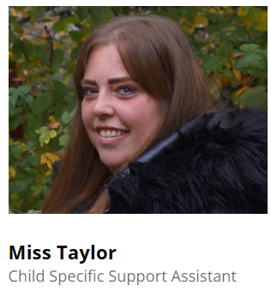
Year 6 staff

Slide 3
Timetables
PE days:
6D – Monday and Wednesday
6S – Thursday and Friday
Forest school Friday – throughout the year

Slide 4
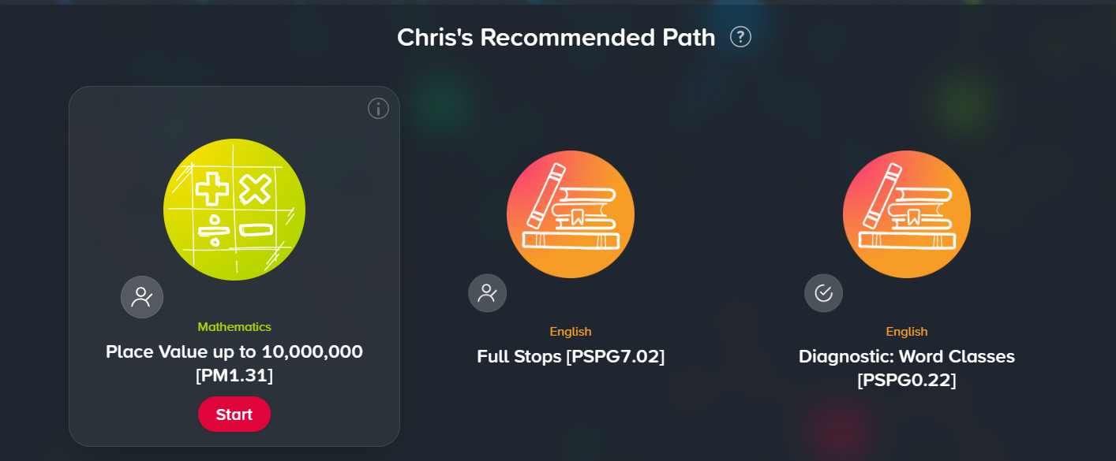
Homework
Century - handed out on Wednesday, due back the following Wednesday.

Slide 5
Homework
Writing homework will be set every three weeks.
Reading every night for at least 10 minutes.
Reading books are expected to be in school every day. An adult needs to sign the child’s organiser.
Regular use of TTRS and revision of times tables if they don’t already know them
Regular use of Spelling Shed – One new pattern each week set to correspond
to 10 weekly spellings which will be tested every MONDAY!

Slide 6
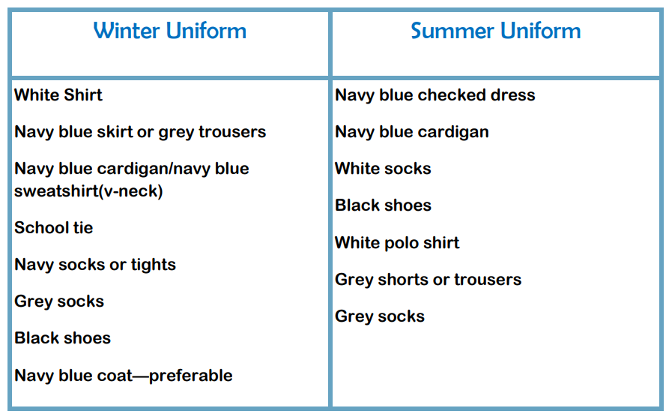
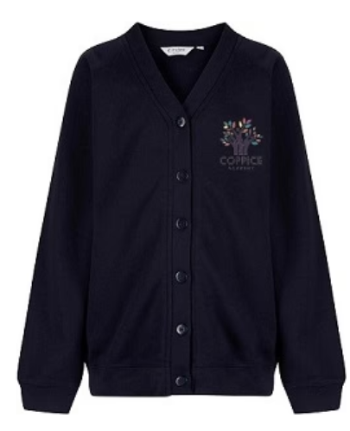
Uniform
For safety reasons, children are NOT allowed to wear jewellery of any kind in school (including earrings).
Hair that is longer than shoulder length is to be tied up with a blue, white or black bobble.

Slide 7
PE Kit
Plain white t-shirt (or one with our school logo on it)
Navy jumper
Navy shorts / joggers
White socks
Trainers

Slide 8

Rewards
We use class dojo to record behaviour.
Good behaviour in line with our values is rewarded with dojo points.
We will have a dojo winner every week.
We will also have a Values champion every week.

Slide 9
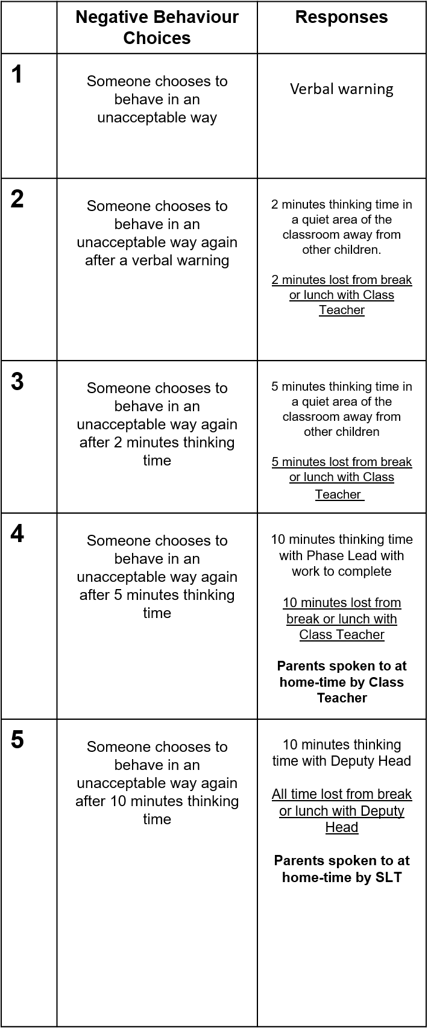
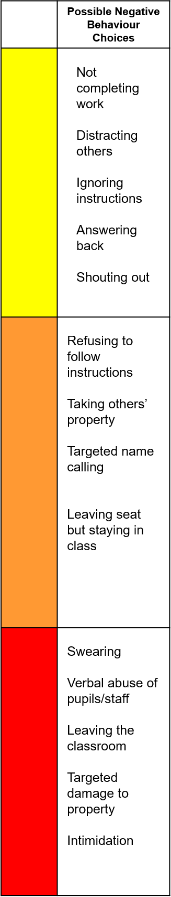
Negative
Behaviour
Choices

Slide 10
Our topics this year
WW2 – assembly to parents
(Tuesday 13th October, 9:15 – 9:45)
Who should go on the next £10 note?
- Researching historical figures such as Alfred the Great.
Investigating local histories through the use of census records
Enterprise – Tenner Challenge

Slide 11

Books we are reading
Goodnight, Mr Tom
Holes
Street Child

Slide 12

Educational Visits
Coventry Cathedral (Friday 25th September)
Blackwell Residential (June 2027 – dates TBC)
Swimming (Summer 2)
Transition days to secondary school (July)

Slide 13
SATS
Monday 10th - Thursday 13th May 2027
SPAG (spelling, punctuation and grammar)
Reading,
Maths - arithmetic and 2 reasoning papers
Children’s writing is monitored and assessed by us.

Slide 14
Finally…
If your child is worried or upset or you are concerned about anything
at all, please get in touch.
Class dojo messages are checked regularly.
Emails can be forwarded to us – please use the office email address
office@coppice.solihull.sch.uk
Urgent messages and reports of absences – please telephone the office.
Please approach us at the end of the school day if you have any questions.

Slide 15
We are really looking forward to teaching your children this year.
Thank you for listening.
Any questions?

