Slide 1



Slide 2
A few points before we begin…
Some of the information we will be discussing will be of a sensitive nature and may make some experience some discomfort.
Staff will be available after this session to discuss any misunderstandings or clarifications about the programme’s content here or in a more private location.
Please wait patiently until the end of the session to ask questions or seek further information.

Slide 3
What is No Outsiders?
Teaching children diversity and tolerance | Andrew Moffat, Birmingham | Global Teacher Prize

Slide 4
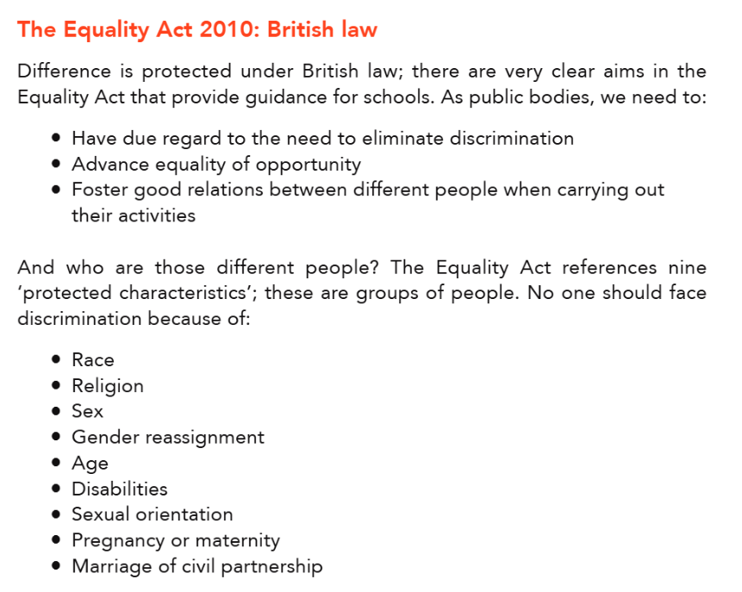
Legal Preface
We want children to see that
“difference is a positive, not a negative. After all, we are all different; none of us is exactly the same; we are all unique
(OFSTED Handbook, 2023)

Slide 5
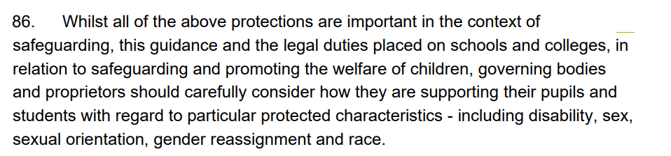
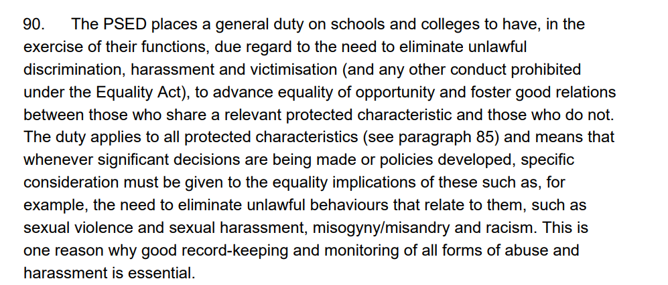


KCSIE (2025)

Slide 6

British Values

Slide 7

What does No Outsiders look like here?

Slide 8
Whole School Provision
Adherence to No Outsiders framework to deliver an inclusive curriculum built
around picture books written for children aged 4-11 years old.
6 x discrete No Outsiders PHSE lessons (one per half term)
Selection of 43 No Outsiders approved lesson plans and assembly ideas
Selection of 43 No Outsiders approved picture books to support delivery
Regular No Outsiders Assemblies using approved lesson plans and delivered by
SLT or Phase Lead.

Slide 9




Year 3
Spring
Summer
To recognise
stereotypes
To show respect
To show welcoming behaviour
To find common ground

Slide 10




Year 4
Spring
Summer
To understand how families
change
To consider how my language affects others
To show acceptance
To speak up

Slide 11




Year 5
Spring
Summer
To exchange dialogue and express and opinion
To find self-acceptance
To consider responses to racist behaviour
To try not to judge by appearance

Slide 12




Year 6
Spring
Summer
To consider how new experiences affect us all
To consider responses to change
To consider attitudes towards disability
To find common ground

Slide 13
LO: To try not to judge by appearance

Slide 14
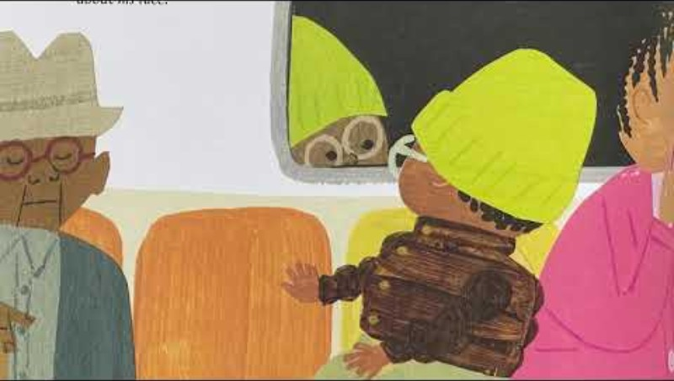

Slide 15
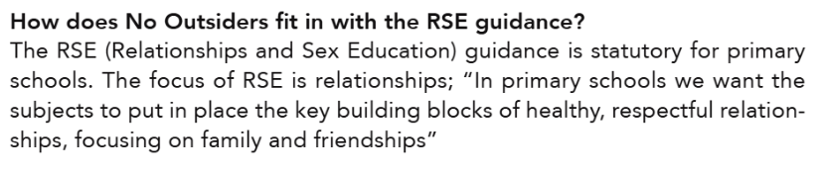
Common FAQs

Slide 16
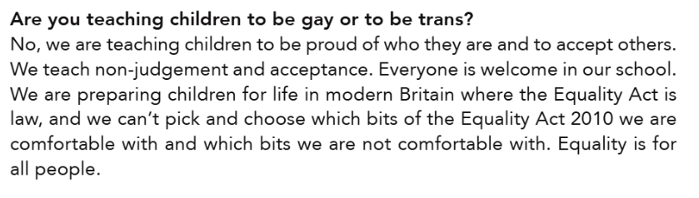
Common FAQs

Slide 17
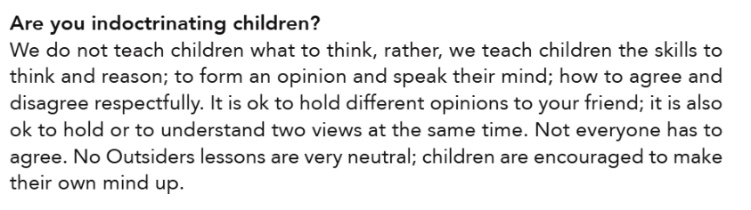
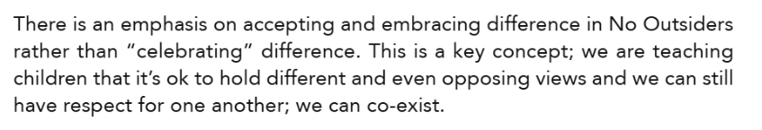
Common FAQs

Slide 18
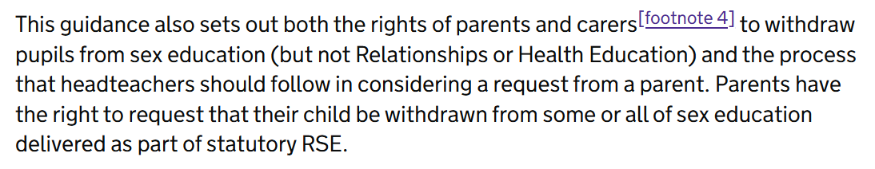


Common FAQs

Slide 19
So, why No Outsiders again?
My family is different (No Outsiders)

Slide 20
Please feel free to explore the resources…
All No Outsiders picture books that are used here at Coppice Academy
All No Outsiders sample lesson plans that are used by our staff here.
Video testimonials from a range of key stakeholders (on Ipads)

