Slide 1

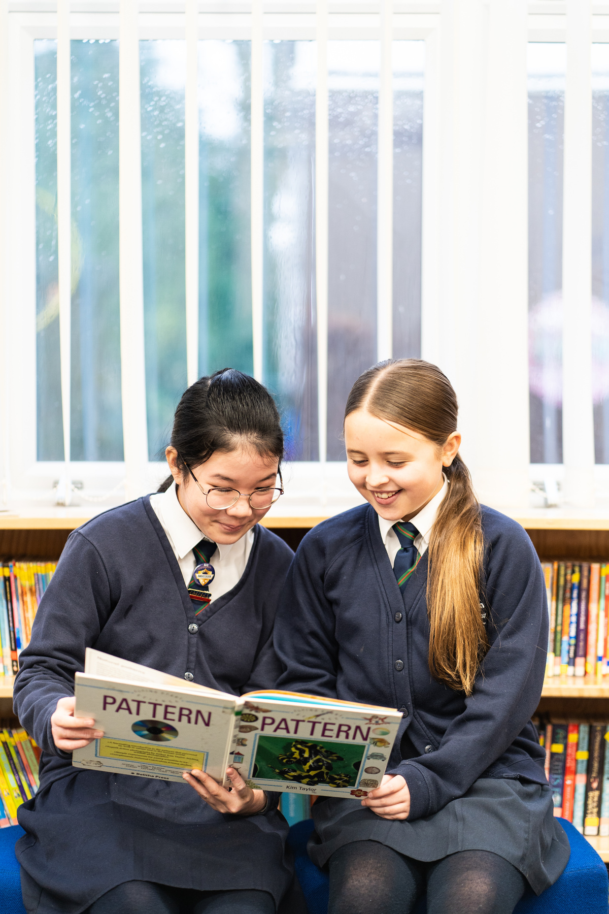

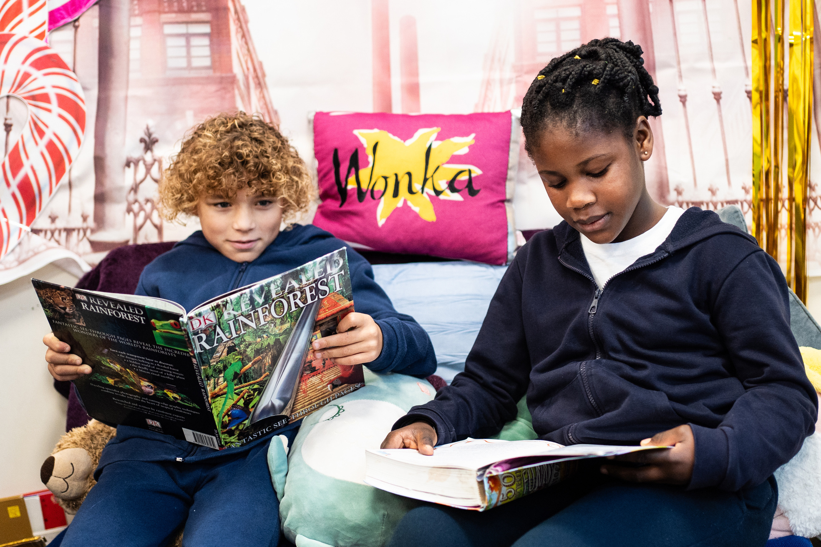

Inspiring Excellence
COPPICE ACADEMY
Welcome
Notes:
Welcome!
Headteacher here since Nov 22.
Joined AMAT in September 2023.
Many improvements in the school recognised by Ofsted June 2023 - Good school.

Slide 2



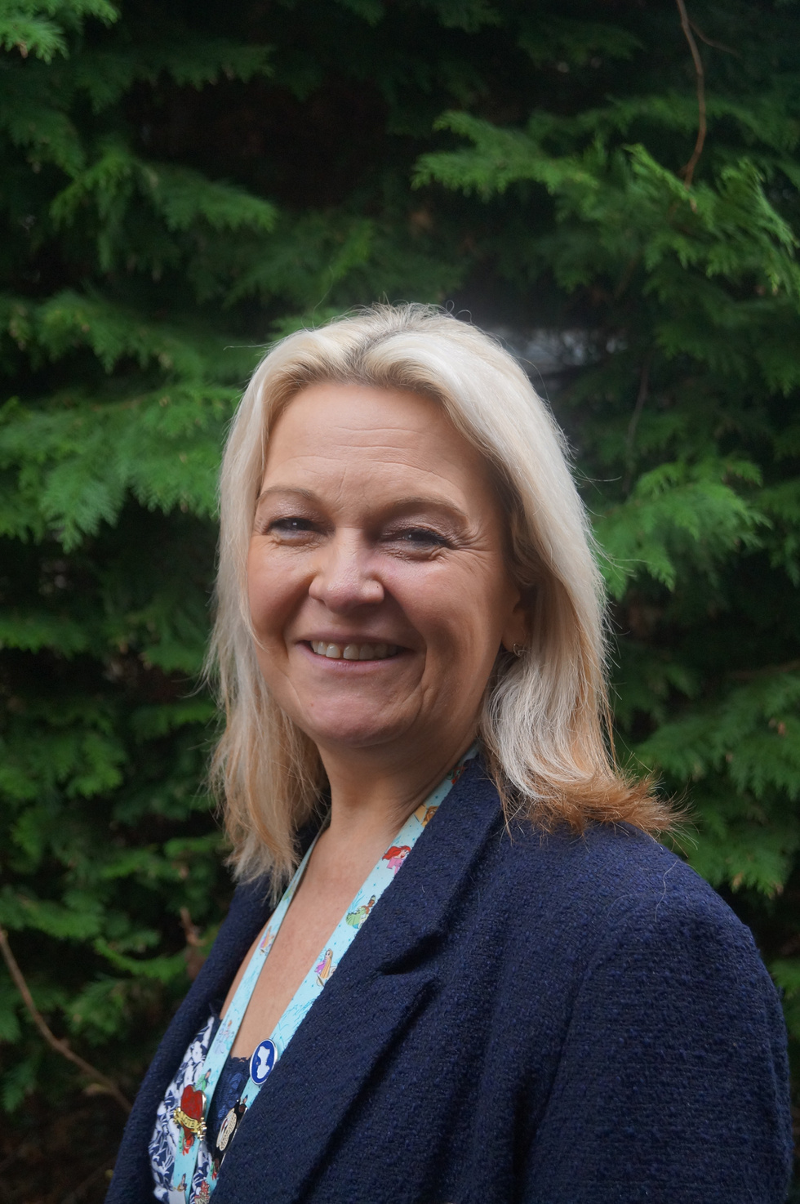
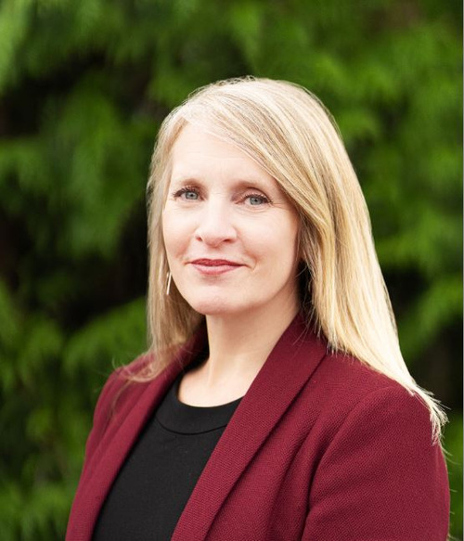
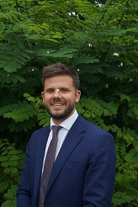



SENIOR TEAM
Mrs Ros Ashe
Mrs Mel Green
Mr Fowler
Director of Primary Education
Associate Headteacher
Deputy Headteacher
Notes:
Mel

Slide 3
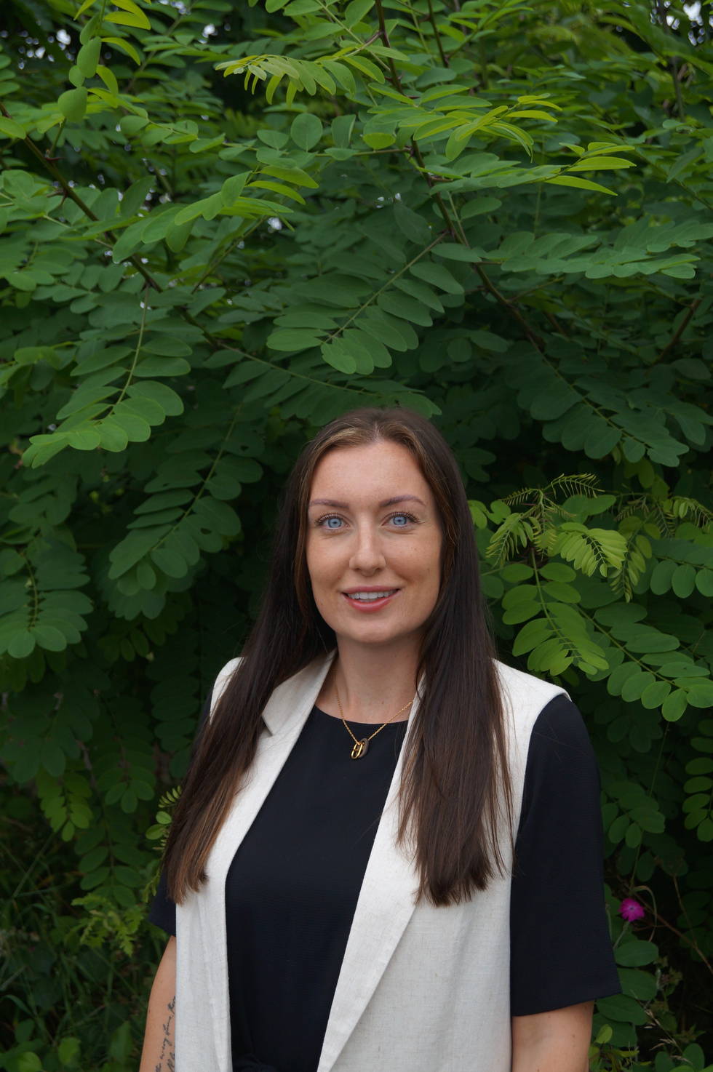
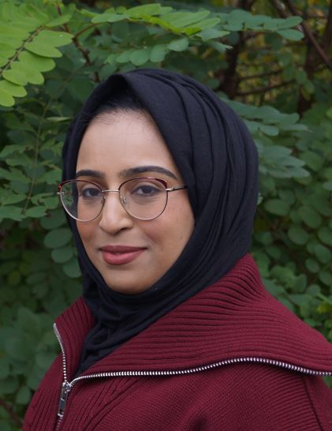

INCLUSION TEAM
Miss Jade Cooper
Mrs Zara Khan
SENCO
Family Support Worker

Slide 4
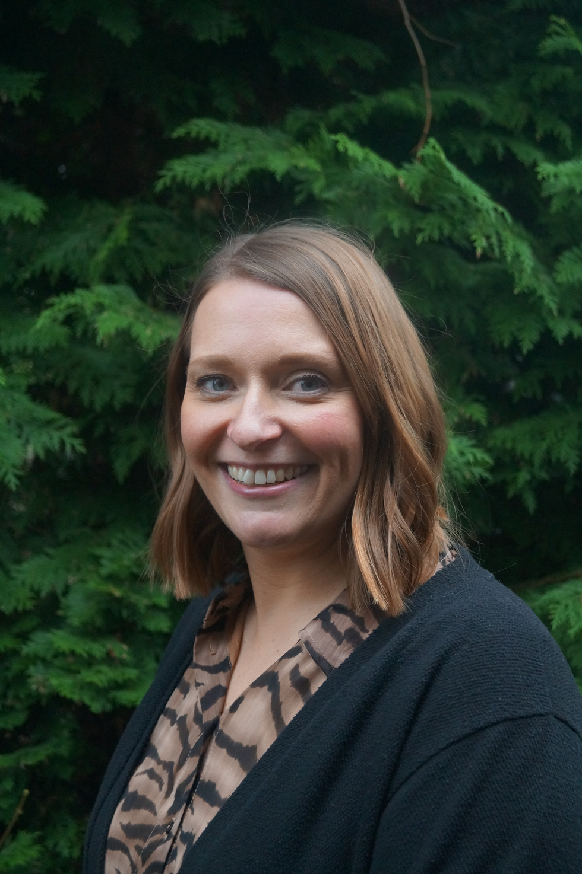
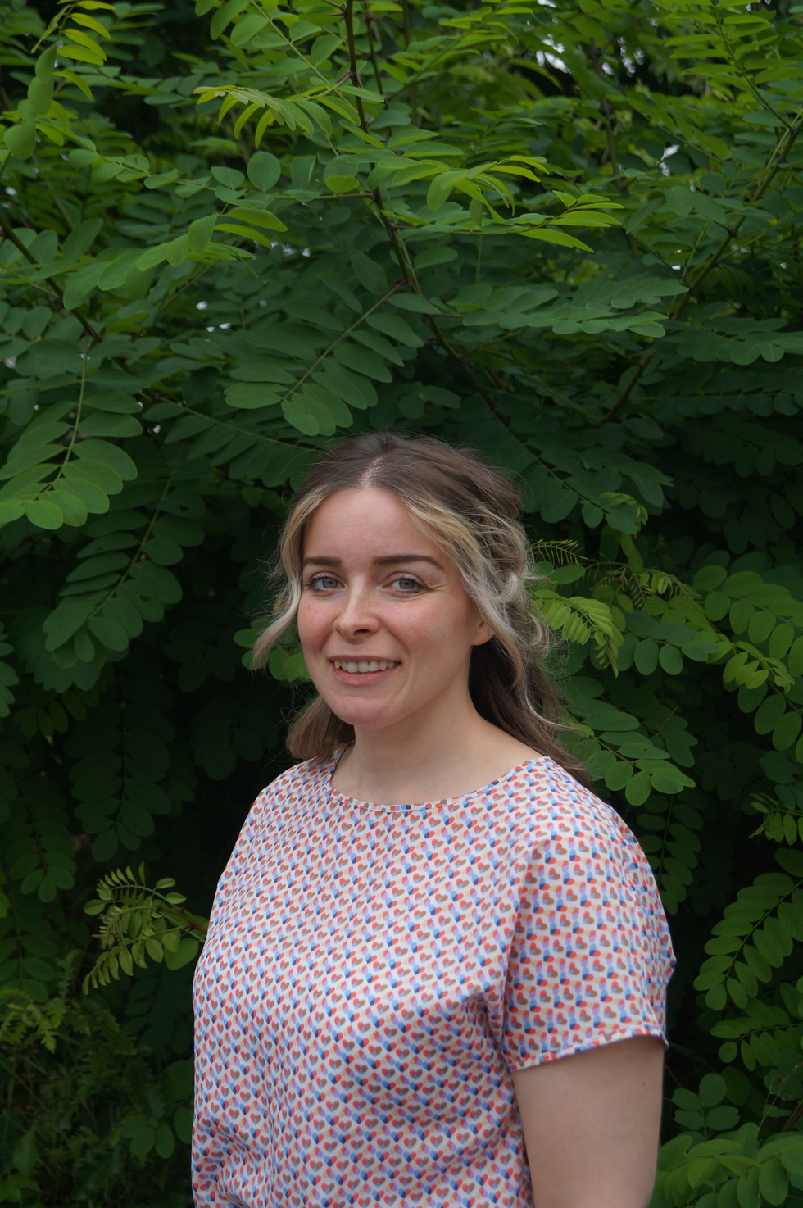
YEAR 3 TEAM
Mrs Jen Edwards
Mr Fowler
Miss Sleeman
Class Teacher
Deputy Headteacher
Class Teacher
Notes:
Mel

Slide 5






COPPICE VALUES
Independence
Creativity
Perseverance
Respect
Compassion
Co-operation
Notes:
Mel

Slide 6
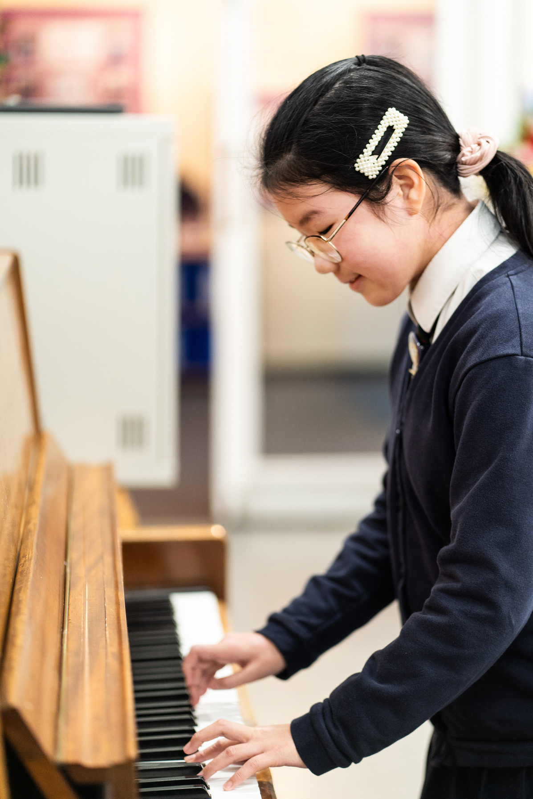









THE COPPICE WAY
How we do things here... high expectations
High expectations of behaviour
High expectations of attendance
High expectations of learning
Inspire through opportunity
Notes:
Mel

Slide 7

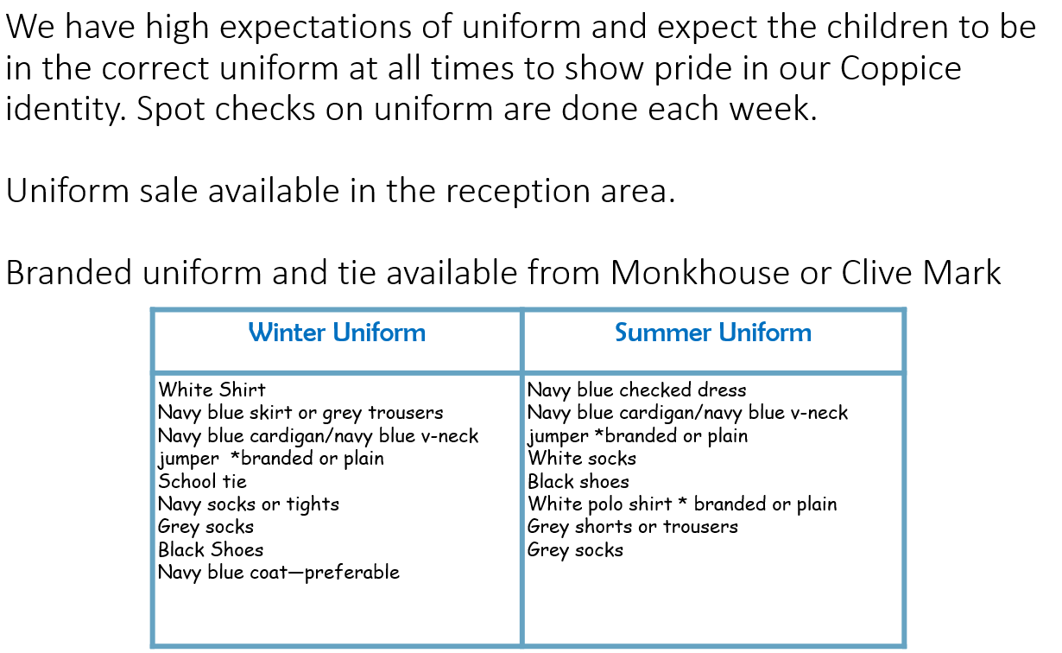
UNIFORM
Notes:
Mel

Slide 8
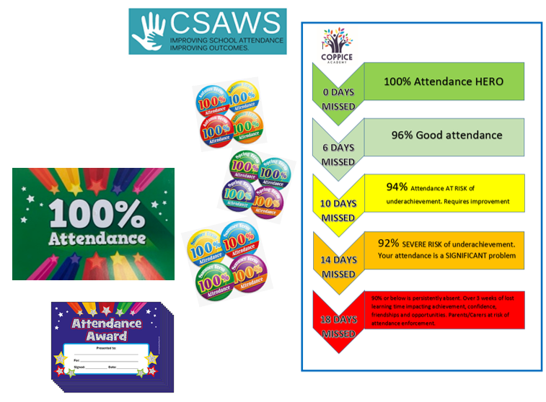

ATTENDANCE
Notes:
Mark

Slide 9






REWARDS AND
BEHAVIOUR
Notes:
Mark

Slide 10
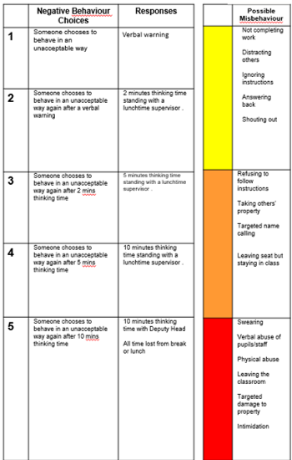


BEHAVIOUR AT COPPICE
Notes:
Mark

Slide 11




Ofsted June 2023
‘Pupils are keen learners and enjoy coming to school. They feel safe because adults care
for them and look after them. Staff
know pupils very well and work hard to
nurture their talents and interests’.
‘Work with external organisations to support pupils and their families is strong. Through the curriculum, staff teach pupils how to stay safe, both in school and when outside in the community’.
Notes:
Mel

Slide 12






SAFEGUARDING
DSL’s
All children have their named ‘trusted adult’
Online Safety
Online safety taught through Jigsaw curriculum,
e-safety week, assemblies and the computing curriculum.
Parents – ‘Wake Up Wednesday’
guides posted on the school Facebook page
and letters home.
Mrs Green
Mrs Khan
Mr Fowler
Notes:
Mel

Slide 13

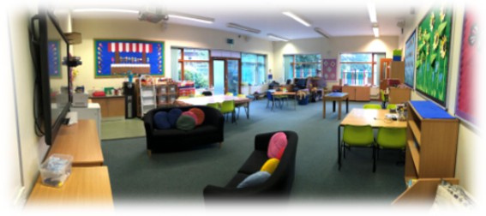

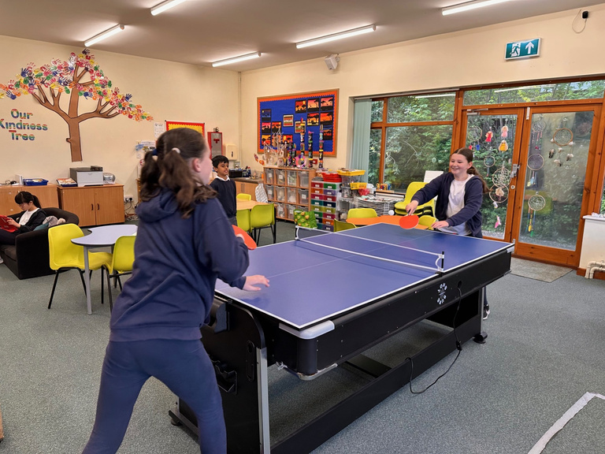
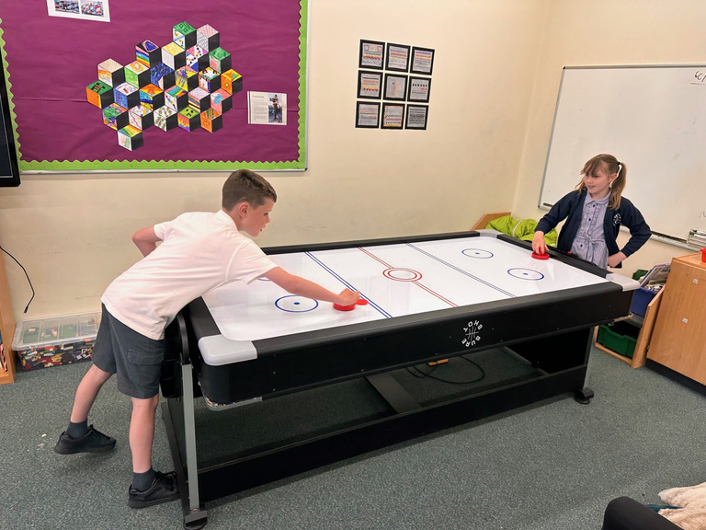
THE DEN
The Den is located at the front of the building with easy access
from the gate for collection and pick up.
The club operates between the following hours:
Before School Club (includes light snack served until 8:30am)
Breakfast from 7:45 am £6.50
Breakfast from 8:00am £5.25
After School Club (includes snack at 3:30pm and light tea after 5pm)
End of school – 4pm £5.257
End of school – 5pm £8.05
End of school – 6pm £11.25
Ad hoc bookings can also be made.
Notes:
Mark

Slide 14

Notes:
Mel

Slide 15


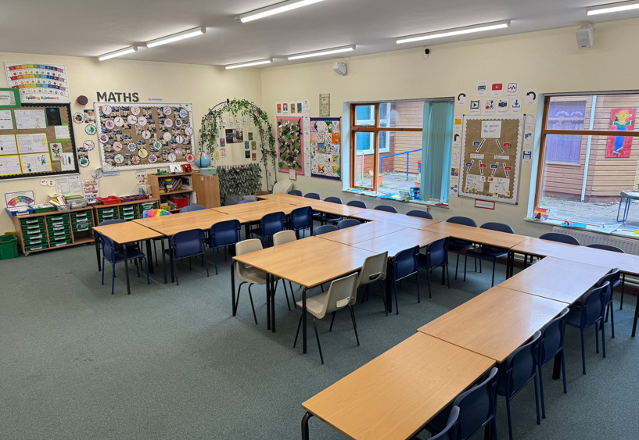

OPPORTUNITIES
•Clubs
•Sports Provision – in house and local authority
tournaments
•Eco Council
•School Council
•Digital Leaders
•Peer Mediators Year 5
•House Captains Year 6
•Trips – Year 3 Birmingham Museum & Art Gallery
(history focus) Botanical Gardens (science focus),
Tri-golf tournament and Tag rugby tournament
•School boys and girls football team
•Book Club at ‘Starbooks’ in the Library
•Arts projects & exhibitions
•Writing competitions ‘500 Words’
•Choir
Notes:
Mel

Slide 16

Notes:
Mel

Slide 17

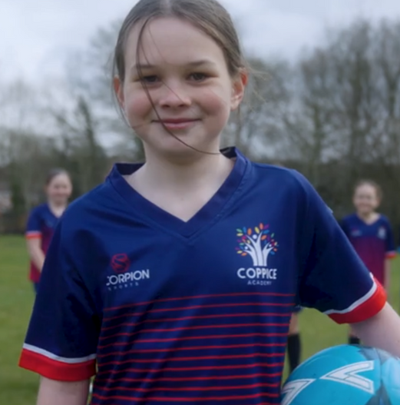
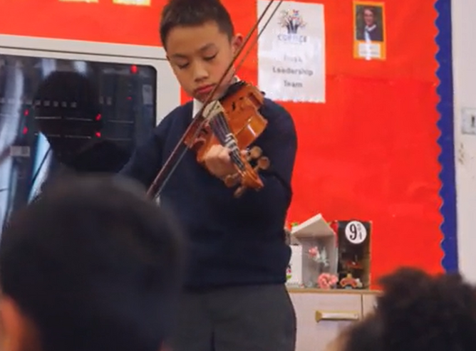
OTHER OPPORTUNITIES AT COPPICE....
Grace
Jaydden
Notes:
Mel

Slide 18
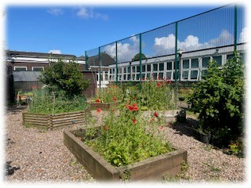
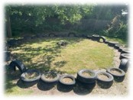
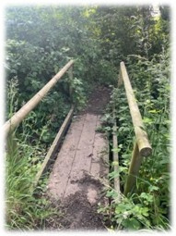

Year 3 & 4 Focus: Speech and language.
Social, emotional and mental health focus
Year 5 & 6 Focus: Skills based
Notes:
Mark

Slide 19




READING SCHOOL
The Big
20 mins
Record reading in the Home School organiser
Class reading percentages shared in celebration assembly each week
Reading Champion awarded each week
Notes:
Mark

Slide 20




HOMEWORK
Maths and SPaG is set each week on Century every Wednesday.
Writing homework is sent home every 3 weeks. A wiring book will be sent home for your child.
Year 3&4 and Year 5&6 statutory spellings to be sent home. The children will be tested on these in school.
Notes:
Mel

Slide 21

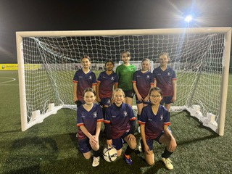
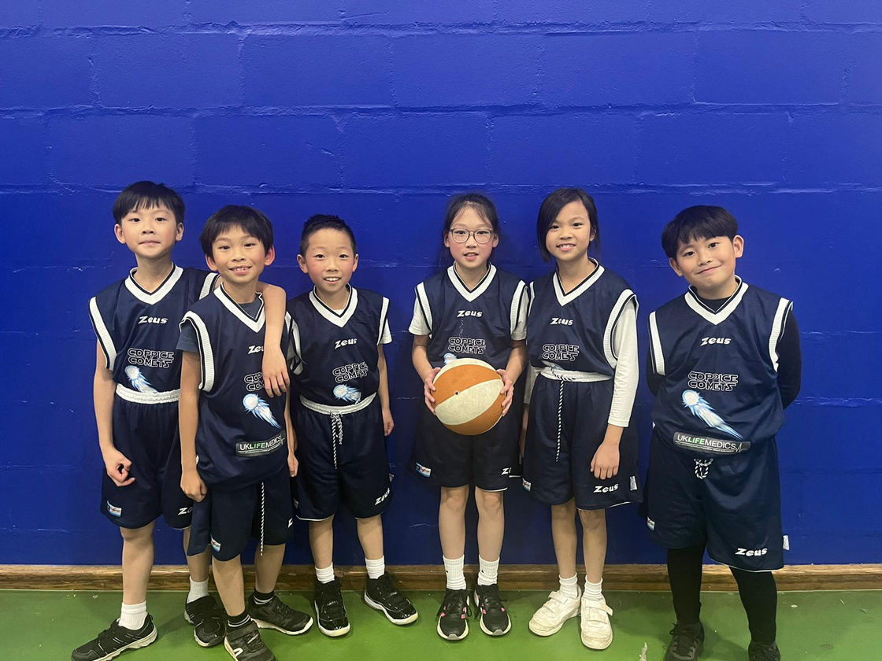
SPORTS
Football
We have offered over 200 pupil places at after-school sports clubs (inc 20 SEND-specific) across 17 sports clubs since September 2024.
Attendance at 21 inter-school fixtures, competitions or events across KS2 since September (4 still to come!)
Basketball
Notes:
Mel

Slide 22



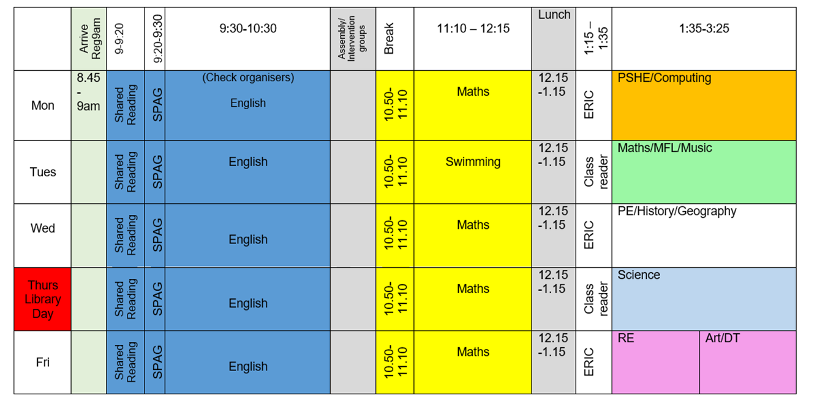

WHAT WILL THEY DO?
Notes:
Mark

Slide 23
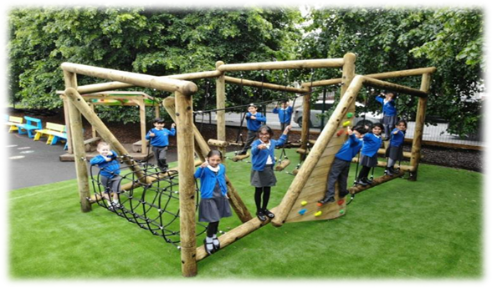
PARENT SCHOOL ASSOCIATION
A wonderful group of parents who help to raise vital funds for the school
The money raised went towards purchase of: •Dance workshop to celebrate Lunar New Year
•Phonics reading texts
•Eid biscuits and decorations for school
•New trim trail and climbing equipment.
School Fund
We ask parents to make a contribution
of £10 per child £15 per family
Notes:
Mel

Slide 24
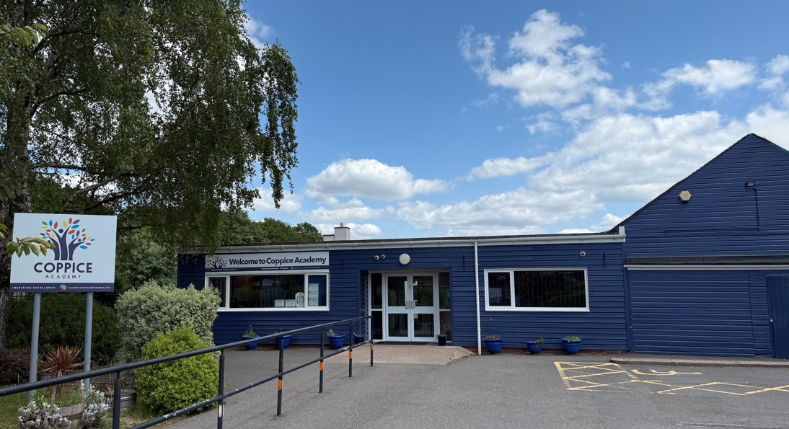





CONTACT US
if you want to contact us or want more detailed information, contact us below:
0121 705 3504
17office@coppice.solihull.sch.uk
www.coppiceacademy.co.uk
Coppice Road
Solihull
West Midlands
B92 9JY
Notes:
Mel

