Slide 1

Meet the Teacher
Year 5
2025 -2026

Slide 2

Year 5 Teachers
Mr Fraser – 5F
Miss Wright – 5W
Miss Ridsdale – TA Support

Slide 3

Timetables
PE days:
5F – Tuesday and Thursday
5W – Tuesday and Friday
Guitars : Wednesday
Homework given on a Wednesday and due the following Wednesday (Century/Writing)
Forest School Friday – throughout the year, we will dojo to remind when this is happening
(old clothes and wellies will be needed for this)

Slide 4

Uniform
White shirts / polo shirts (shirts and ties after October Half Term please).
Blue skirts (or blue check summer dresses until Oct Half Term) /
grey trousers or shorts
Navy jumper or cardigan – with school logo if you prefer
Dark socks and black shoes
Long hair needs to be tied up - blue / white / black hair bobbles
No jewellery (including earrings)
Watches may be worn (no smart watches).

Slide 5

PE Kit
Plain white t-shirt (or new school logo PE shirt)
Navy jumper
Navy shorts / joggers
White socks
Trainers

Slide 6


Rewards / Consequences
We use class dojo to record behaviour.
Good behaviour in line with our values is rewarded with dojo points.
At the end of each week, the child with the most points will be recognised in assembly and receive a certificate.
Negative behaviour is class will result in a warning being given. If behaviour continues, 2 minutes thinking time is given. If behaviour continues, this increases to 5 minutes and then it will be 10 minutes with Mr Smith (Phase Lead).
Children will pay this time back during break/lunch time.
We will endeavour to inform you of these events.
Serious bad behaviour - physical incidents or bad language will be
reported straight to Mr. Fowler or Mrs Green.

Slide 7
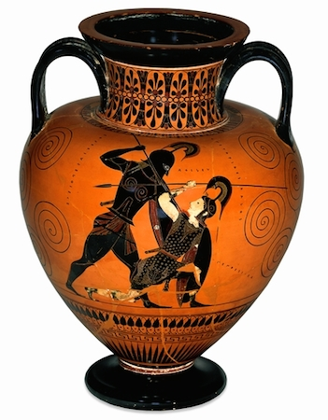


Year 5 Topics
Autumn Term - Ancient Greece/Life in the Alps
Spring Term - Space / Tudor Life/Why do Oceans matter?
Summer Term – Anglo Saxons and Vikings/Life Cycles/The Desert

Slide 8

Books we are reading
Ancient Greek (Non-Fiction text)
The Lion, The Witch and the Wardrobe by CS Lewis
Can you get Rainbows in Space? (Non-Fiction text)
Coming To England by Floella Benjamin
Kick by Mitch Johnson

Slide 9

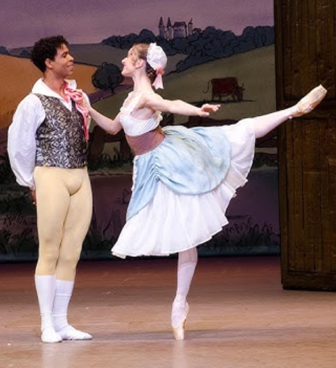
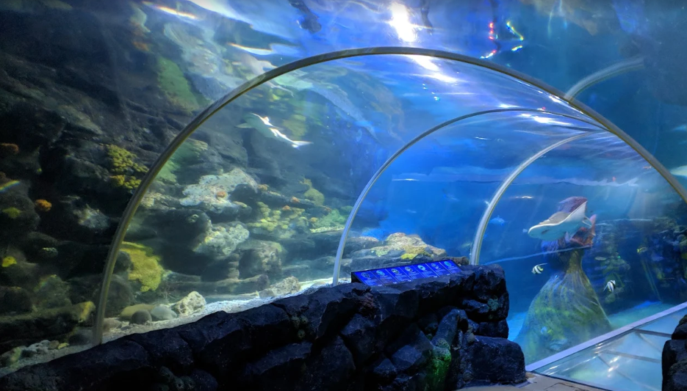

Educational Visits
We are going to see the Royal Ballet in November.
We will be taking the children to the Space Centre in the Spring
term to enhance their learning during their Science
Space topic.
We will also hopefully be visiting the Sea Life
Centre, in Birmingham, during our Oceans topic.

Slide 10
On the Playground…
Peer mediators:
24 Y5 children will be trained to help resolve any disagreements on the playground.
They do this in a restorative manner, helping children to solve their own problems and come up with constructive solutions.
2 days of training which will be given by Miss Wright, with booster sessions run across the year.
Will work on a rota in pairs.

Slide 11

Homework
All children are expected to read for 10 minutes, at least three
times a week, ideally though this would be every night. Please
sign their reading diary pages in their organiser to confirm they have
done so.
Reading books need to be in school every day.
If they have read and bring their book in, the get 2 ticks on the class chart. The class with the highest percentage on a Friday win extra playtime.
Homework will be given on a Wednesday and due the following Wednesday. This will be done via Century.
CENTURY

Slide 12

Spellings
Spellings will follow a similar format to last year.
We start the year with a 50-word common exception words baseline spelling test.
The each fortnight, a set of words will be displayed in the classroom.
Over the course of 2 weeks, the children will complete activities linked to the spelling patterns and be taught to identify these words in our learning across all subjects.
At the end of the fortnight, there will be a progress check on these words.
Children are formally assessed at the end of each term
to ascertain progress with another 50-word spelling
challenge.

Slide 13
Finally…
If your child is worried or upset or you are concerned about
anything at all, please get in touch.
Class Dojo messages are checked regularly.
Emails can be forwarded to us – please use the office email address
office@coppice.solihull.sch.uk
Urgent messages and reports of absences – please telephone the office.
Please do come to speak to us at the end of the school day if you have any questions.

Slide 14
We are looking forward to teaching your children this year.
Thank you for listening.
Any questions?

