Slide 1

Parent Information Evening
Year 4
2025-2026

Slide 2

The Year 4 Team
Class Teacher: Miss Carr
Support staff: Miss Ahmed, Ms Chiu, Mrs Cole

Slide 3
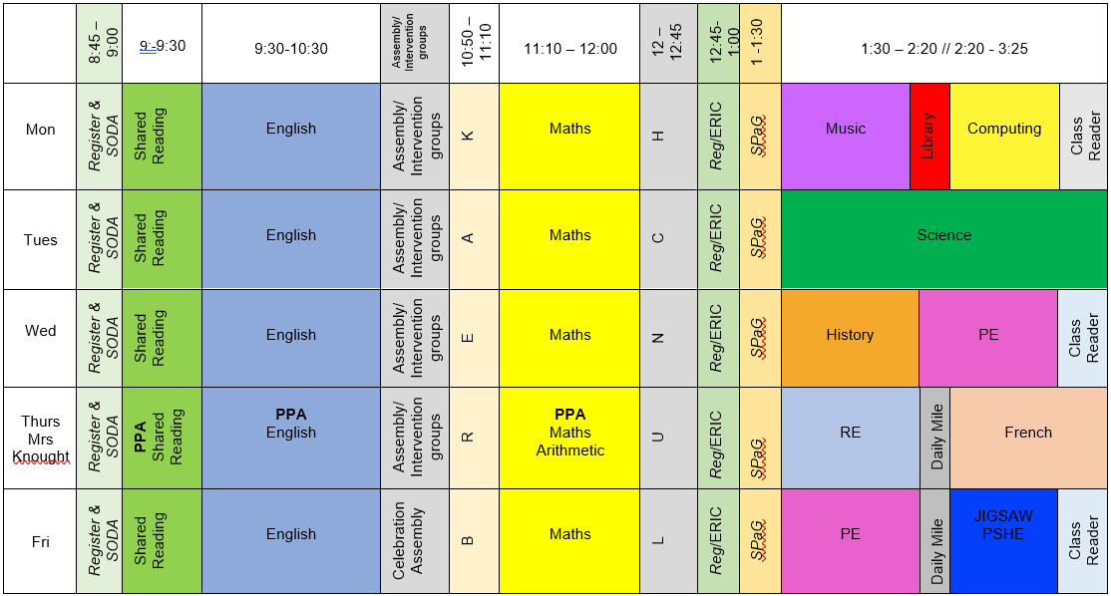
Class timetable
PE: Wednesday and Friday
Homework set on a Wednesday and due the following week

Slide 4
Uniform
White shirts / polo shirts (Shirts and ties after October Half Term please)
Blue skirts (or blue check summer dresses until Oct Half Term) / grey trousers or shorts
Navy jumper or cardigan – with school logo if you prefer
Grey socks and black shoes
Blue / white / black hair bobbles. Long hair tied back.
No jewellery including earrings

Slide 5
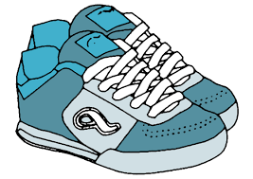
PE Kit
Navy Shorts / Joggers
White T Shirt
Navy Hoody
White Socks
Trainers

Slide 6
Rewards / Sanctions
We use Class Dojo to record positive behaviour and where children receive Dojo points.
The child with the most points that week will get a certificate in assembly.
Poor behaviour will follow our behaviour chart, starting with verbal warnings and missing time from break or lunch.
Serious incidents are reported straight to Mr Fowler or Mrs Green.

Slide 7
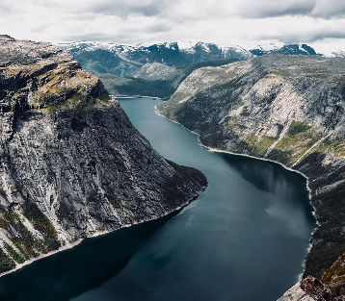
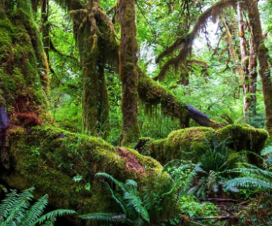
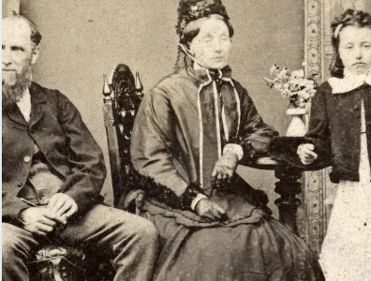
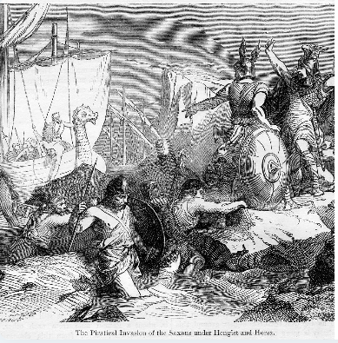

Year 4 Topics
Autumn Term – How Children’s lives have changed and Where food comes from.
Spring Term – What changed in Britain after the Anglo-Saxon invasion? And Rainforests
Summer Term – The achievements of the Ancient Maya impacted society and Rivers

Slide 8
Homework
Reading | We encourage reading at home daily for 10 minutes per day, please sign your child’s home school organiser when reading has been completed.
Century | Children will use the same login as last year, it will be set on a Wednesday and due the following week. This homework will include maths and/or English.
TTRS | With the times table check this year please encourage your children to login in regularly to practice their times tables
Spellings / spelling shed | Spellings are set on a Monday and will be tested once a fortnight. We will also set spellings on spelling shed to support with this.
Writing | Writing homework is set once every 3 weeks.

Slide 9

Books we are reading
Wreck of the Zanzibar by Michael Morpurgo
Rainforest Non Fiction Text
The Firework Maker’s Daughter – Phillip Pullman
Coppice 100 reads – please encourage your child to read as many of these as possible.

Slide 10
Multiplication Times Table Check
What is the Multiplication tables check?
It is an on-screen check consisting of 25 times table questions. Your child will be able to answer 3 practice questions before taking the actual check. They will then have 6 seconds to answer each question.
On average, the check should take no longer than 5 minutes to complete.
Normally happens in June, date tbc nearer to the time.
We will be completing practice checks across the school year
Do I need to do anything to prepare my child for the check?
No, you do not need to do anything additional to prepare your child for the check.
As part of usual practice, we encourage you to give your child lots of opportunities to practise their times tables through TT Rockstars.

Slide 11
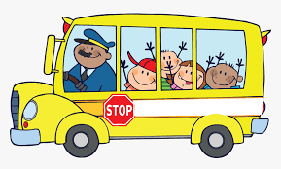
Educational Visits
We have our first trip, a trip to Cadbury World on 24th September
We are hoping to take the children on trips to enhance their learning across the year and information of these will be circulated.

Slide 12

Finally…
If your child is worried or upset or you are concerned about anything at all, please get in touch.
Class Dojo messages are checked regularly
Emails can be forwarded to us – please use the office email address
office@coppice.solihull.sch.uk
Urgent messages should be telephoned to the office
Please approach us at the end of the school day.

