Slide 1

Year Group Expectations
Year 3
2025 - 2026

Slide 2
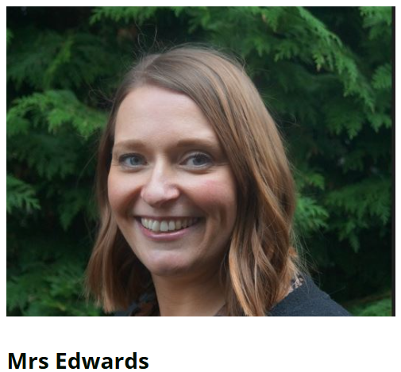
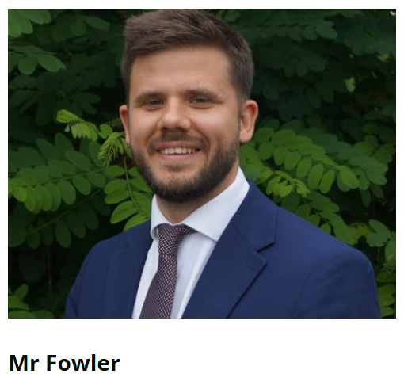
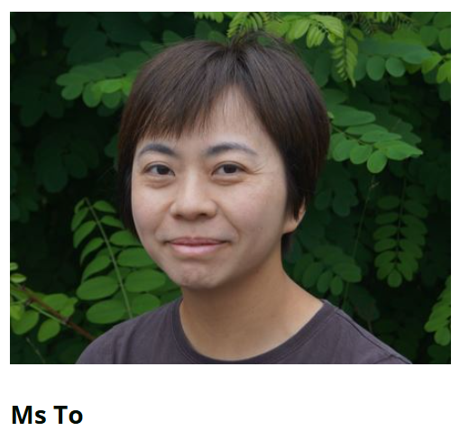
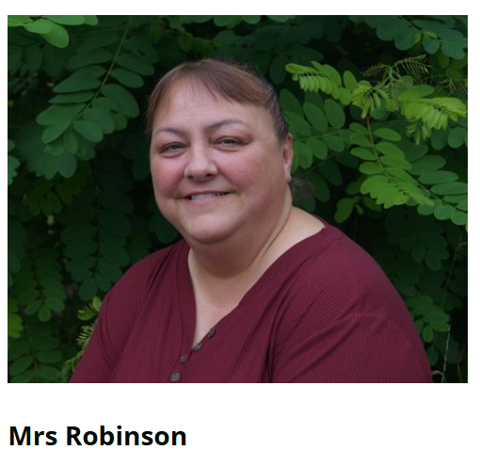
3EF Staff
Mrs Edwards – Class Teacher (Tues – Fri)
Mr Fowler – Class Teacher (Mon)
Miss Milicic – Support
Ms To – Support
Miss Robinson - Support

Slide 3

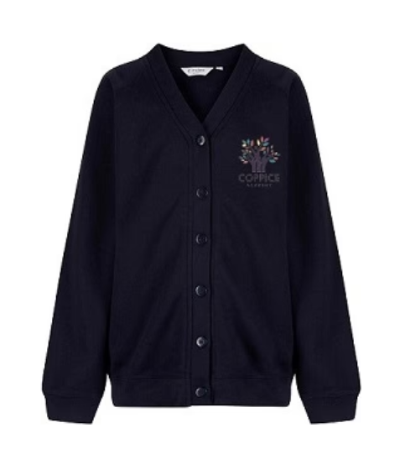

Uniform
White shirts / polo shirts (Shirts and ties after October Half Term please)
Blue skirts (or blue check summer dresses until Oct Half Term) / grey trousers or shorts
Navy jumper or cardigan – with school logo if you prefer
Grey socks and black shoes
Blue / white / black hair bobbles. Long hair tied back.
No jewellery including earrings
Watches maybe worn.

Slide 4


PE
Our PE days are Monday and Thursday.
Children can come to school in their PE kit on these days:
Plain white t-shirt (or one with our school logo on it)
Navy jumper
Navy shorts / joggers
White socks
Trainers

Slide 5


Rewards
We use class dojo to record behaviour.
Good behaviour in line with our values is rewarded with dojo points.
We will have a dojo winner every week.
We will also have a Values champion every week.
Negative behaviour is class will result in a warning being given. If behaviour continues, 2 minutes thinking time is given. If behaviour continues, this increases to 5 minutes and then it will be 10 minutes with Mr Smith.
Children will pay this time back during break/lunch time.
We will endeavour to inform you of these events.
Serious bad behaviour - physical incidents or bad language will be reported straight to Mr Fowler or Mrs Green.

Slide 6




Homework
Century - set on Wednesday, due back the following Wednesday.
Writing homework will be set every three weeks.
Reading every night for at least 10 minutes.
Reading books are expected to be in school every day. An adult needs to sign the child’s organiser.
Children are expected to use Times Tables Rock Stars and Spelling Shed regularly throughout the week to work on times tables and spellings.
Login details will be sent out in organisers.

Slide 7
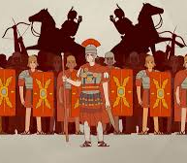
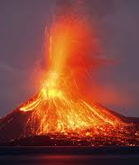
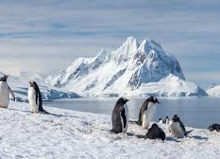
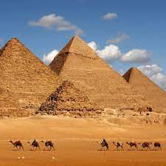
Year 3 Topics
Autumn Term – Stone Age/Bronze Age/Iron Age – Volcanoes
Spring Term – Romans – Antarctica
Summer Term – Ancient Egyptians - Settlements

Slide 8



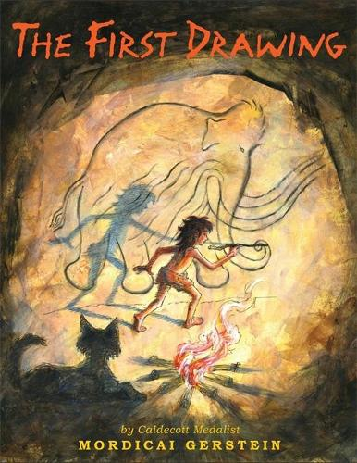
Books we are reading
The First Drawing
The Hodgeheg
Escape from Pompeii
Frida Kahlo
Bill’s New Frock
A planet full of Plastic
Charlotte’s Web
The Tin Forest

Slide 9
Spellings
Each fortnight, 15 words will be displayed in the classroom
Over the course of 2 weeks, the children will complete activities linked to the spelling patterns and be taught to identify these words in our learning across all subjects,
At the end of the fortnight, there will be a progress check on these words.
Children are formally assessed at the end of each term to ascertain progress.
Children can work on the common exception words on Spelling Shed at home. These words are in their organisers for reference.

Slide 10

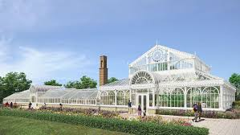
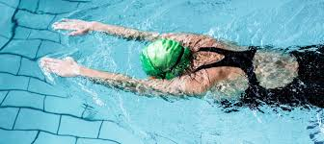
Educational Experiences
Stone Age Day (Portals to the Past) – Autumn term
The Botanical Gardens- Summer term
Swimming – Summer term

Slide 11


Finally…
If your child is worried or upset or you are concerned about anything at all, please get in touch.
Class Dojo messages are checked regularly
Emails can be forwarded to us – please use the office email address
office@coppice.solihull.sch.uk
Urgent messages should be telephoned to the office
Please approach us at the end of the school day.

Slide 12

We are looking forward to teaching your children this year.
Thank you for listening.
Any questions?

